Slide 1
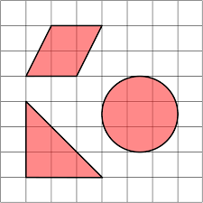
Area

Slide 2
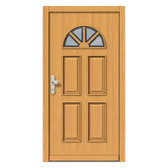
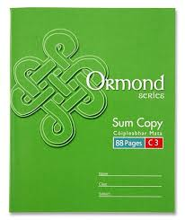
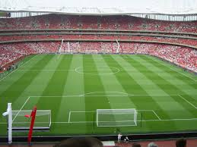
What is area?
Area is how much space a surface or shape takes up, and it is measured in squares!
Which of these would have the biggest area?
Smallest area
Biggest area
Notes:
It is different from length or width, which measure a side of shape. Area is how much space a surface or shape covers. It can be very useful to know an objects area, for example if you were putting down a carpet in a sitting room, you find the area of the room, and then you know exactly how big the carpet needs to be!
Here we have a 1 euro coin, a maths copy, a hall door, and a stadium.

Slide 3
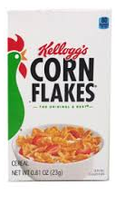
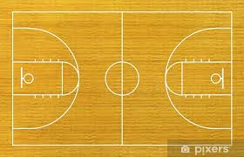
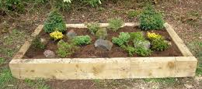
Put these in order from smallest to largest area
2
1
3
4
Notes:
Which of these would have the smallest area? We have a door mat, a box of cereal, a flower bed, and a basketball court. We know that area is the amount of space a shape covers, so which of these is the smallest? Which would be the biggest? Check your answers

Slide 4
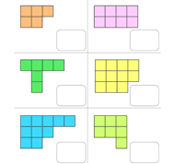
We measure area by counting squares

Slide 5
Counting trickier shapes
2 half squares make 1 whole square!

Slide 6
What is the area of these shapes?
Remember: 2 half squares makes 1 whole square!

