Slide 1
Advertisements
Have a look at these 5 advertisements and think about the following questions:
What makes the advert good?
Did they use any powerful words or phrases to try to catch your attention?
Did they use any pictures or images?
Is it colourful?
Would you do/buy what the advert is telling trying to convince you of?

Slide 2
Does this look fun and exciting?
In what ways?

Slide 3
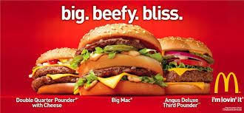
How does this advert make you feel?

Slide 4
What information is in this advert which might make you want to go to the circus?

Slide 5
How are they trying to persuade you in this ad?

Slide 6
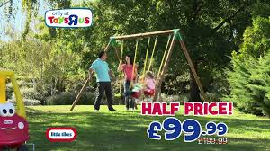
What technique can you spot in this advertisement, which is trying to convince you?

Slide 7
Take a close look at some adverts you might see on the TV or on the internet.
Have a think about the way they are advertising and whether you think it is effective or not.

